Slide 1
MINI PROJECT
ELECTRICITY BILL

Slide 2
C - LANGUAGE
C was invented to write an operating system called UNIX.
C is a successor of B language which was introduced around the early 1970s.
The language was formalized in 1988 by the American National Standard Institute (ANSI).
The UNIX OS was totally written in C.
Today C is the most widely used and popular System Programming Language.
Most of the state-of-the-art software have been implemented using C.
Today's most popular Linux OS and RDBMS MySQL have been written in C.

Slide 3
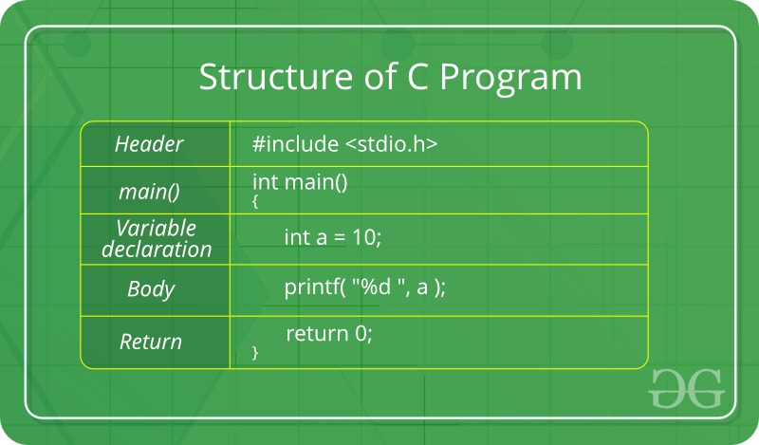
STRUCTURE OF C PROGRAMMING

Slide 4
ELECTRICITY BILL
Electricity is a powerful form of energy that is essential to the operation of virtually every facility in the world. It is also that can represent a significant portion of a manufacturing facility’s cost of production.
This energy management primer is intended to introduce some electricity billing fundamentals, especially focusing on the two major aspects of the electricity bill, demand and energy.

Slide 5
Write a program in C to calculate and print the Electricity bill of a given customer. The customer id., name and unit consumed by the user should be taken from the keyboard and display the total amount to pay to the customer. The charge are as follow :
Unit | Charge/unit
up to 199 | @1.20
200 and above but less than 400 | @1.50
400 and above but less than 600 | @1.80
600 and above | @2.00
If bill exceeds Rs. 400 then a surcharge of 15% will be charged and the minimum bill should be of Rs. 100/-

Slide 6
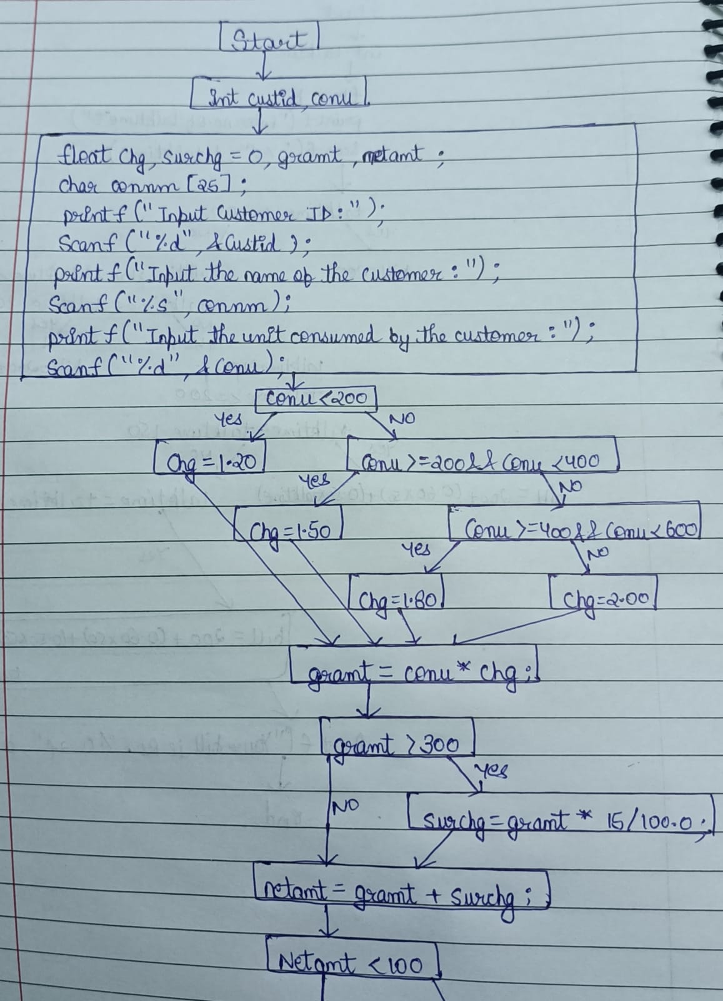
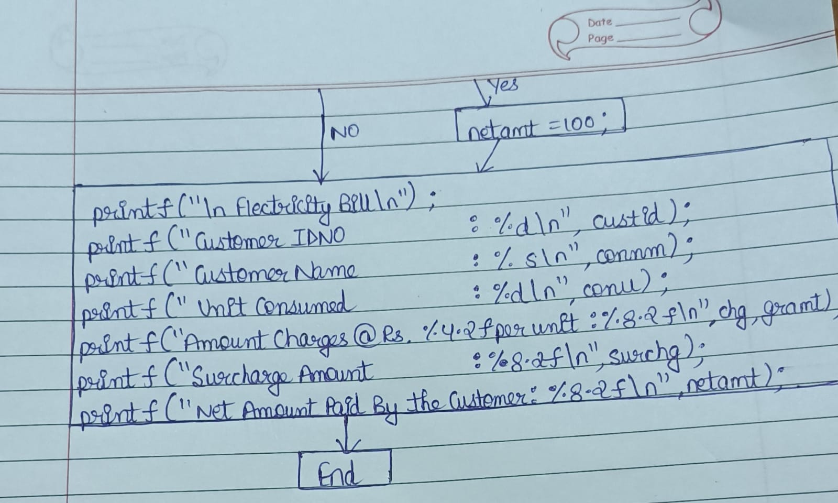
FLOWCHART

Slide 7
C- PROGRAMMING CODE
#include <stdio.h>
#include <string.h>
int main()
{
int custid, conu;
float chg, surchg=0, gramt,netamt;
char connm[25];
printf("Input Customer ID :");

Slide 8
scanf("%d",&custid);
printf("Input the name of the customer :");
scanf("%s",connm);
printf("Input the unit consumed by the customer : ");
scanf("%d",&conu);
if (conu <200 )
chg = 1.20;
else if (conu>=200 && conu<400)
chg = 1.50;
else if (conu>=400 && conu<600)
chg = 1.80;
else
chg = 2.00;

Slide 9
gramt = conu*chg;
if (gramt>300)
surchg = gramt*15/100.0;
netamt = gramt+surchg;
if (netamt < 100)
netamt =100;
printf("\nElectricity Bill\n");
printf("Customer IDNO :%d\n",custid);
printf("Customer Name :%s\n",connm);
printf("unit Consumed :%d\n",conu);
printf("Amount Charges @Rs. %4.2f per unit :%8.2f\n",chg,gramt);
printf("Surchage Amount :%8.2f\n",surchg);
printf("Net Amount Paid By the Customer :%8.2f\n",netamt);
return 0;
}

Slide 10

THANK YOU
SUBMITTED BY- KRISHNA JHANWAR(RA2111004010278)
SUBMITTED TO – Mr.S.INIYAN

